Slide 1
The 2nd International Conference on Emerging Trends in Engineering (ICETE 2023)
Paper id- 9117
Title of the Paper-BCI based home automation system by using SSVEP Signals
Author 1 : D.Suman, Associate Professor, Osmania University
Author 2 : Pavani Thadem, Osmania University
Author 3 : Zurian Ketema, UNICEF, Jamaica, USA
Presenting Author – Pavani Thadem, Osmania University
1

Slide 2
CONTENTS
Background
Introduction
Literature Review
Objectives
Methodology
Results And discussions
Conclusions & Future scope

Slide 3
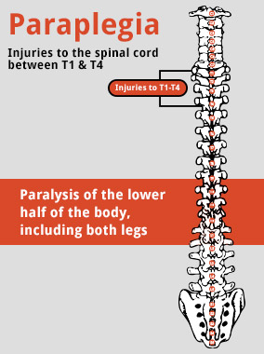
Background
Brain-computer interfaces (BCIs) acquire brain signals, analyze them, and translate them into commands that are relayed to output devices that carry out desired actions.
The major goal of BCI research is to develop a system that allows disabled people to communicate with other persons and also helps to interact with external control devices. These control devices promote greater independence by enabling people to perform tasks with the help of technology.
Steady state visually evoked potentials (SSVEP) are signals that are natural responses to visual stimulation at specific frequencies.
SSVEP is often used in brain-computer interfaces (BCIs). They are especially popular in rehabilitation and enhancement research
3

Slide 4

OBJECTIVE
Objectives of the project is to
design and development of a portable visual stimulator
Perform Data collection
Implement Pre-processing and feature extraction of EEG signals
Detect SSVEP and control of home appliances

Slide 5
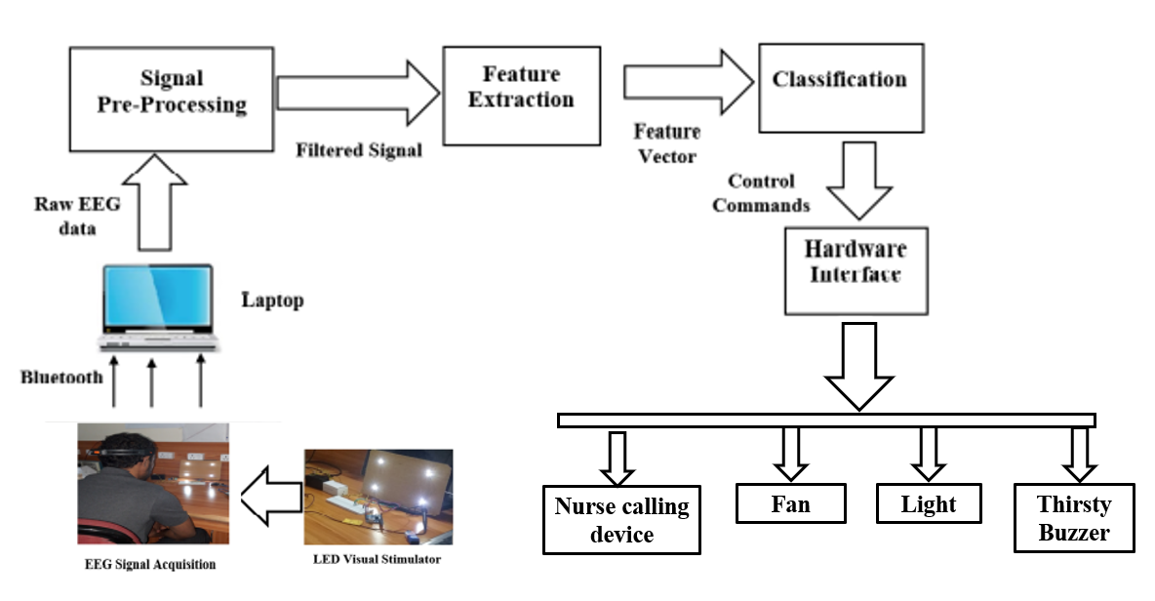
METHODOLOGY
Fig 1: Block diagram of SSVEP based BCI

Slide 6
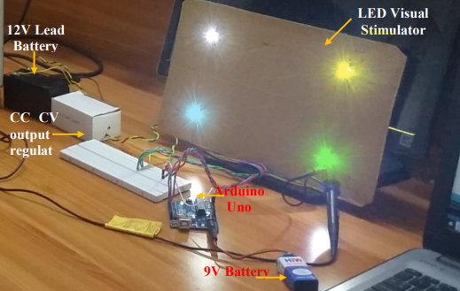
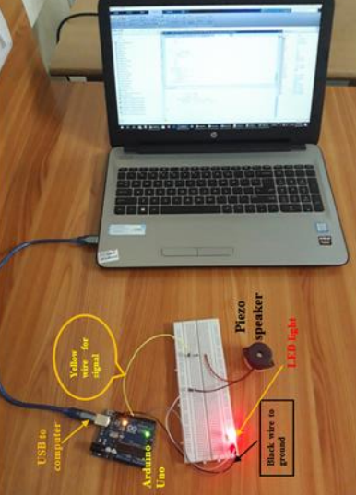
Fig 2: Portable LED Visual Simulator
Fig 3: Experimental Setup

Slide 7
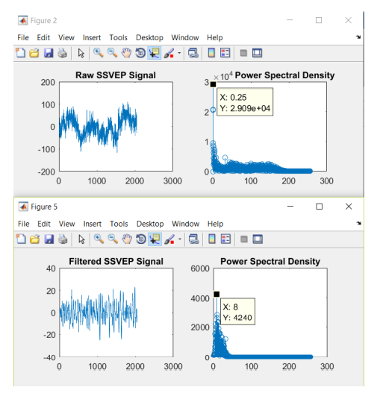
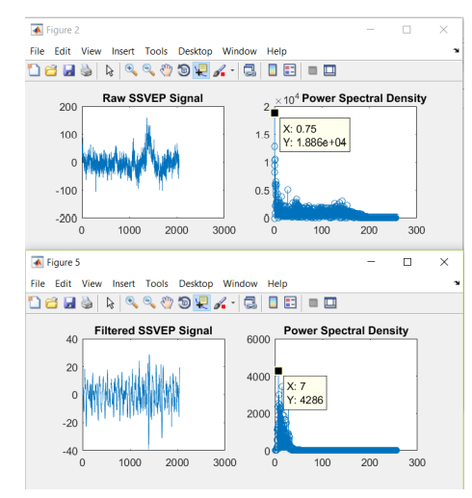
RESULTS AND DISCUSSIONS
Figure 4: Yellow color LED flickering of frequency 7Hz
Figure 5: Green color LED flickering of frequency 8Hz

Slide 8
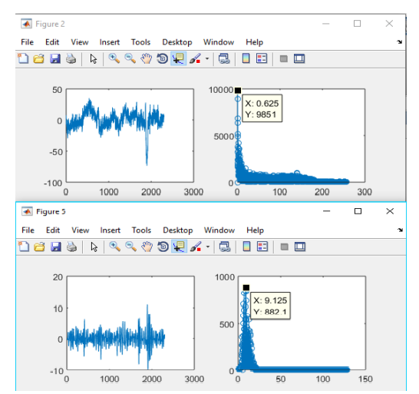
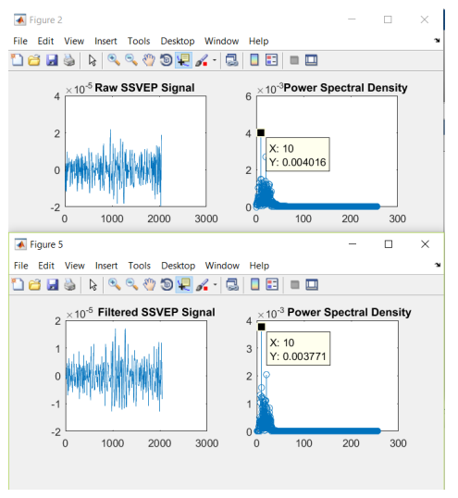
Figure 6: Blue color LED flickering of frequency 9Hz
Figure 7: White color LED flickering of frequency 10Hz

Slide 9
CONCLUSION
A Portable Visual stimulator is developed for BCI based home automation by using four LEDs operated at four different flickering frequencies is designed and developed. Power spectrum analysis of EEG data is carried out to detect the elicited response of the brain to the flickering frequencies. It is found that the Maximum Power Frequency (MPF) is found to be statistically significant (p<0.001)in detection of the flickering frequency of the visual stimulus. This is immensely useful for Tetraplegia patients to operate the nurse emergency call devices and other accessories like fan, light and thirsty devices in the hospital room.. However, nonlinear methods can be used such as ANN, SVM show significant improvements in terms of classification accuracy and usability when applied in the system

Slide 10

Thank you
By- Pavani Thadem

